Slide 1
Software Testing & Challenges
Iflaah Salman (PhD)
19.10.2022

Slide 2

Mentimeter (mentimeter.com)
Go to mentimeter and Enter Code:
3862 5617

Slide 3
Industry
Challenges
related to

Slide 4
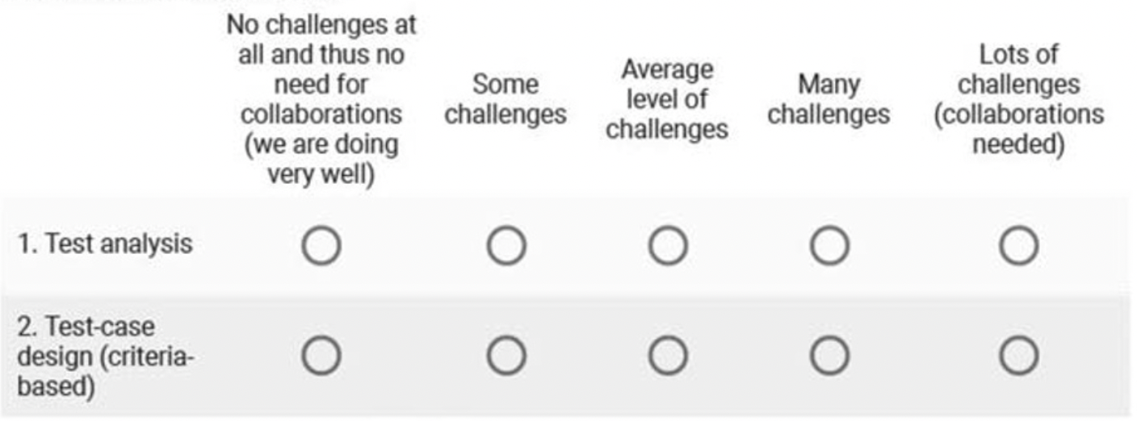
Survey Form
Notes:
This is based on the data collected from 72 practitioners from 8 countries. The majority of the respondents have between 5 and 15 years of work experience. Four respondents had more than 20 years of experience

Slide 5
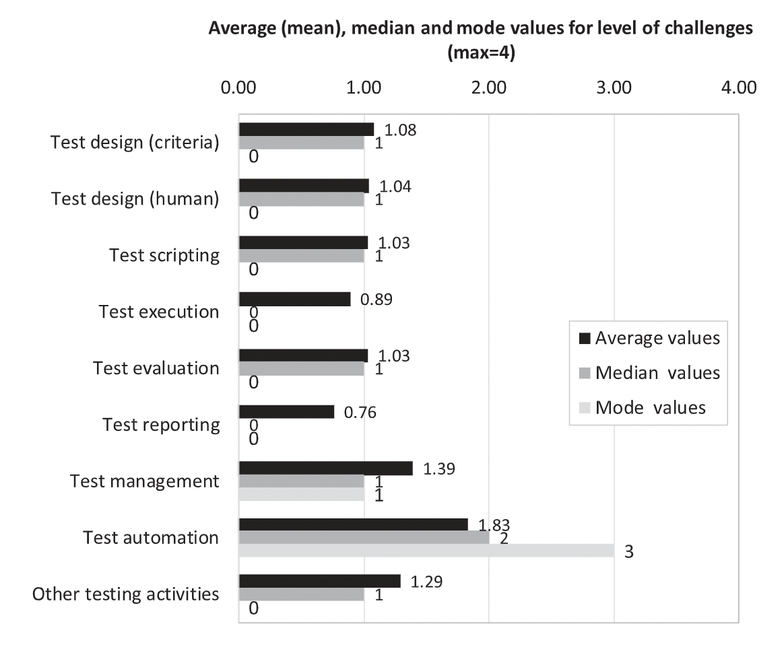
Level or Extent of Challenges
Notes:
The average values of challenges in all test activity types are between [0.76, 1.83] (out of 4) and their median values are all either 1 or 0. This shows that, for most of the test activity types, the majority of the respondents reported low levels of challenges:
relatively high technical maturity/capability of respondents and their teams in the testing activities;
simplicity of testing tasks in their contexts; and/or:
respondents being unaware of having challenges or unaware of being able to conduct testing in a more effective/efficient manner
We see that test management, automation, and “other” test activities have been generally rated higher by practitioners concerning the level of challenges.

Slide 6
Challenging Test Activities
Test Automation
Technical skills limitations
Skills to develop the automaiton script
Tools’ technical limitation that prevents testing for a range of dynamic output
Maintenance of the test suite
Automation coverage for the system under test
Test Management
Tools used for test management
Manual-testing test management tools
Automation testing tools and the suite management
Notes:
Test automation is a key aspect of agile software development practices, many practitioners automate their test suites to meet short delivery cycles: “full” automation of all test activities for a given SUT, quite technically compared to many other test activities (e.g., automation script development skills), test automation is also a relative dynamic area because the underlying system and test technologies as well as the system itself continuously change. In the presence of test automation, the challenge usually “shifts” from the actual test execution to test scripting, i.e., how to best “program” the test scripts and to co-maintain them as the SUT changes,
Test data, test script, all in one tool or multiple tools, a full picture of the test process in one tool or different tools for different testing related activities.

Slide 7

Organisation and Customer
Challenges of Software Testing
related to
Notes:
Testing is not only about the tools and techniques of testing, There are multiple other facotrs that affect software testing.
It is important to know these because they effect the process of software tersting and in turn affect the software quality (construction). These challenges have been gathered after studiying 11 companies operarting in different domains - how organizational activities and stakeholders (customers) affect software testing. Software quality is instilled into the software product throughout the software development life cycle (SDLC). Software Testing is just one phase to ensure software quality via testing (verification and validation concepts) the software.

Slide 8
Organisational Challenges
Project managers giving less attention to testing while planning
Risk taking attitude of Project Managers and Development
Organisational Structure and Mode of Operation
Scope of testing
Notes:
The advantages of early involvement of testers are well known but still project managers did not involve testers early enough in the SDLC.
Consequences: problem of underestimating the resources (time, cost and testers) and scope. So the budget also gets affected.
Didn’t pay much attention to some important tests related to performance testing because they believed that the performance will not be affected and over trust the development team and architecture. An imbalance of functional and non-functional testing.
Vertical structure with many departments, then, it restricts horizontal cooperation with other units or departments: challenge of co-ordinating the involvement of the testers, quality control departments having restricted access and visibility of the quality related activities within projects. the modes of operation did not give testers mandate and accessibility to projects.
Scope of testing is affected by the project contracts and agreements between customers and companies. Bounded by the contract, so overlooked things costs to all, the customer, the company’s prestige and the product’s quality. Tester’s knowledge is also a hindrance to effective testing because it directly relates to the defining of testing scope and its coverage. Defining the scope of testing calls for the participation of all stakeholders have a mutual understanding of what and how things should be done more efficiently.

Slide 9
Customer Challenges
The product that customer wants within:
the resources available
Customer’s payment/budget
The involvement of customer for end-user and usability testing
The knowledge gap between customers, testers and developers
Notes:
Customers play an important role and they can be an impeding factor in the testing process.
The challenge that companies face is not that of building a good and very well tested product, BUT that of providing the product that the customer wants within the limitations of the resources available and the willingness to pay. This means that the result of the testing and the quality of the product may also be influenced by customer choices.
Huge costs for end-user and usability testing, significant amount of time and money considering the company’s resources and the budget. This can be saved If it can be done by the users to test it without bothering them.
During reviews and when making agreements on what is to be tested, a lack of knowledge caused developers, testers or customers to accept things that they did not fully understand.

Slide 10

Human Factors (Motivation & Cognitive)

Slide 11
Motivation
Herzberg’s Motivation-Hygiene Theory:
Extrinsic factors: necessary to achieve some desirable result (material gains [salary, bonus] or increased status)
Intrinsic factors: the reward lies in enjoying the activity itself.
Notes:
An essential challenge for software development organizations is to find effective ways to enhance the motivation and job-satisfaction of their testers. The motivational and de-motivational factors influencing the testing personnel and hence, the testing performed by them.

Slide 12
De-motivational Factors
Lack of influence and recognition (schedule, late involvement, frustration of retesting defects)
Unhappy with management (unrealistic schedules, developers also as testers, insufficient time allocation)
Technical issues (tools, test environments, infrastructure)
Lack of organization (changing plans, resources or processes, unnecessary meetings)
Time pressure (insufficient time to test)
Boredom (maintenance testing with no surprises)
Poor relationships with developers
Working environment issues (noise, office space)
Notes:
lack of control over an unstable schedule, testers’ late involvement in the development cycle, and the struggle for recognition, feeling frustrated by not performing their real job – e.g., more focus on retesting defects rather than testing the requirements or products, Opening a critical defect, and talked down as uncritical by developers, so that the deadline could be met.
unrealistic schedules and a scarcity of resources, frustration of developers when they also have to perform testing due to lack of resources, time allocated to testing to be in-sufficient right from the planning phase.
problems with testing tools, insufficient number of test environments or a weak infrastructure.
The testers being troubled with the continuously changing plans, change of resources or process and volatile test planning. A high number of time-consuming meetings that are often considered redundant or irrelevant for the work tasks.
Traditional working teams often delay testing until the end of projects, squeezing the calendar time available. This causes the testing teams to compress and sacrifice activities due to their shrinking time-frame. Tis is also a problem of Agile software development method.
The feeling of boredom associated with maintenance testing because there are no surprises after the system is in production.
which can be problematic at times. Most ofthese frictions result from discussions related to bugs, developers making unannounced late changes to code were also mentioned as sources of conflict.

Slide 13
Motivational Factors
Enjoy Challenges (testing activities, thriving on the chaos)
Focus on improving the quality (pleasure of finding defects)
Variety of work (involvement in the SDLC)
Recognition (awareness by management and developers)
Good management (healthy relations and communication)
Technically challenging work (tasks per competence, interesting/ boasting technology)
Notes:
Challenges represented by the testing activities, challenging themselves or sometimes simply thriving on the chaos.
the pleasure of investigating and finding defects whose removal will lead to a better product.
being included in the testing activities associated with the whole development cycle, not just a specific phase, combination of programming and testing tasks.
Company’s awareness of the importance of testing, both among management and development teams, positive feedback received from developers related to discovering and fixing bugs.
Having healthy relations and communication with the managers, with other testers and with developers.
The participants’ need to have allocated tasks reflecting their technical competencies, interesting technology to work with that can give a boast to your testing activity.

Slide 14
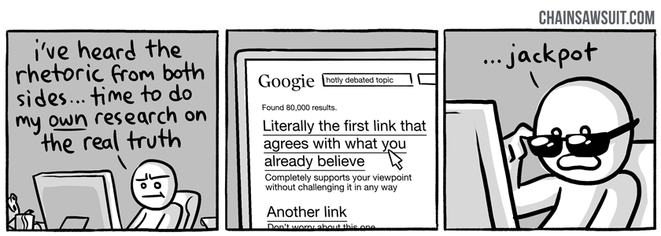
Cognitive Biases
Cognitive bias: In irrational decision in an uncertain event
Confirmation bias: a person’s tendency to look for evidence that strengthens his/her prior beliefs rather than refutes them.

Slide 15
Confirmation Bias
Antecedents:
Lack of training in logical reasoning and mathematical proof reading; experience and being active in a role (developer / tester)
Varied level of domain-expertise
Presence of errors
Ambiguous or Incomplete specifications
Time pressure
High priority functionalities
Automated Testing

Slide 16
Confirmation Bias
Effects:
Higher defect rate
More post-release defects
Running more tests that show a system works than tests that find problems
No out-of-the-box thinking – less domain coverage

Slide 17
Mentimeter (mentimeter.com)
Go to mentimeter and Enter Code:
2839 5622

Slide 18
Mentimeter (mentimeter.com)
Go to mentimeter and Enter Code:
1914 3645

Slide 19
References
Garousi, V., Felderer, M., Kuhrmann, M., Herkiloğlu, K., & Eldh, S. (2020). Exploring the industry’s challenges in software testing: An empirical study. Journal of Software: Evolution and Process, 32(8). https://doi.org/10.1002/smr.2251
Seth, F. P., Taipale, O., & Smolander, K. (2014). Organizational and Customer related Challenges of Software Testing: An Empirical Study in 11 Software Companies. IEEE Eighth International Conference on Research Challenges in Information Science (RCIS), 1–12. https://doi.org/10.1109/RCIS.2014.6861031
Deak, A., Stålhane, T., & Sindre, G. (2016). Challenges and strategies for motivating software testing personnel. Information and Software Technology, 73, 1–15. https://doi.org/10.1016/j.infsof.2016.01.002
Mohanani, R., Salman, I., Turhan, B., Rodriguez, P., & Ralph, P. (2018). Cognitive Biases in Software Engineering: A Systematic Mapping Study. IEEE Transactions on Software Engineering, 46(12), 1318–1339. https://doi.org/10.1109/TSE.2018.2877759
Salman, I., Rodriguez, P., Turhan, B., Tosun, A., & Gureller, A. (2020). What Leads to a Confirmatory or Disconfirmatory Behaviour of Software Testers ? IEEE Transaction on Software Engineering, 5589(c), 1–18. https://doi.org/10.1109/TSE.2020.3019892

